Slide 1
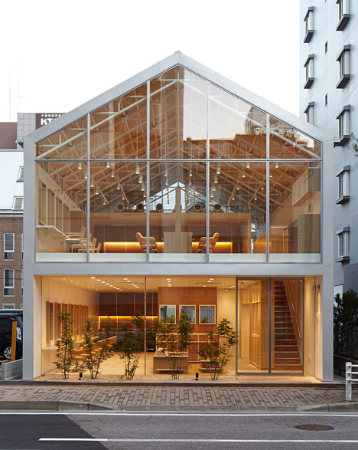
PROJECT: BEAUTY PARLOUR

Slide 2

1. JANNATUL FARDOUS - 2013-2-60-028 2. SYEDA MEHANAZ SADIKEN - 2013-2-60-036 3. MARIA YASMIN NILA – 2013-2-60-047 presenting you…………….
WELCOME

Slide 3
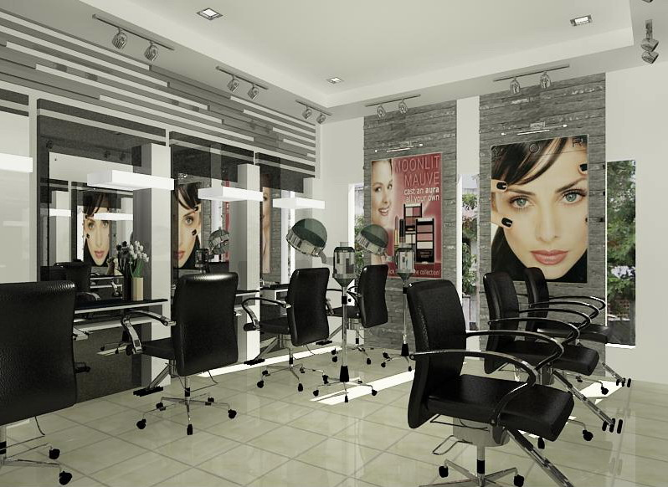
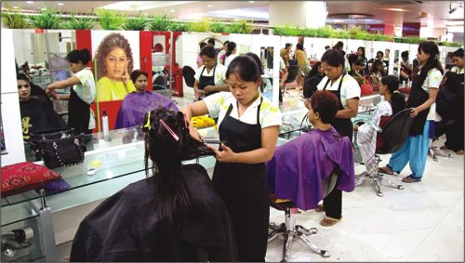
JMB NATURAL BEAUTY PARLOUR

Slide 4
EXLPANATION OF THE TOPIC OF OUR PRESENTATION..
THE NAME OF OUR PROJECT IS BEAUTY PARLOUR……SO WE HAVE MADE A PRESENTATION ON THIS PROJECT…..FIRST OF ALL WE ARE GOING TO SEE WHAT EVER FACILITIES ARE THERE IN OUR PARLOUR

Slide 5
FACIAL NAME
1. Normal Facial .......................... 350tk
2. Herbal Facial .......................... 400tk
3. Gold Facial .......................... 800tk
4. White Facial .......................... 800tk
5. Neem Facial .......................... 350tk
6. Orange Facial .......................... 500tk
7. Cleansing facial .......................... 200tk
8. Fruit Facial .......................... 600tk
9. Acne Facial .......................... 400tk

Slide 6
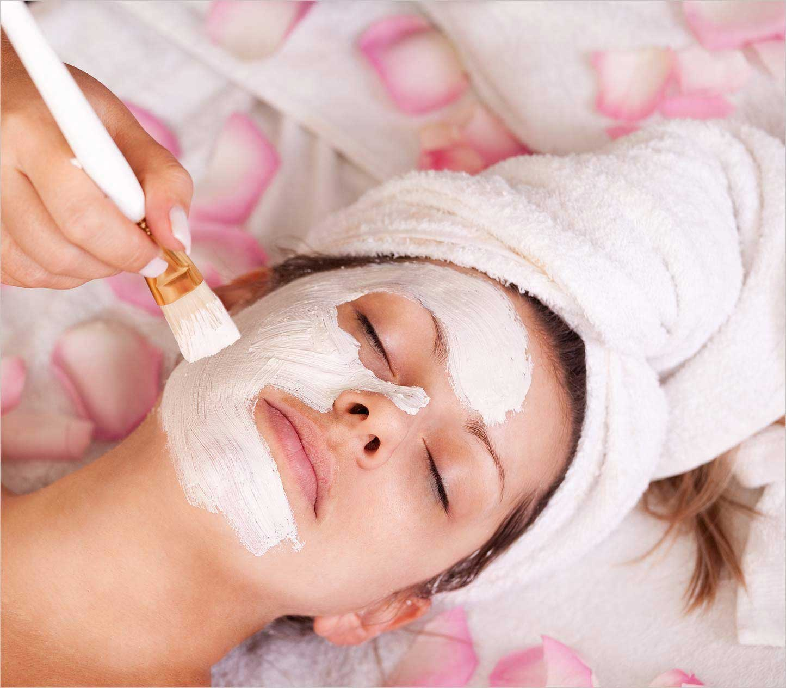
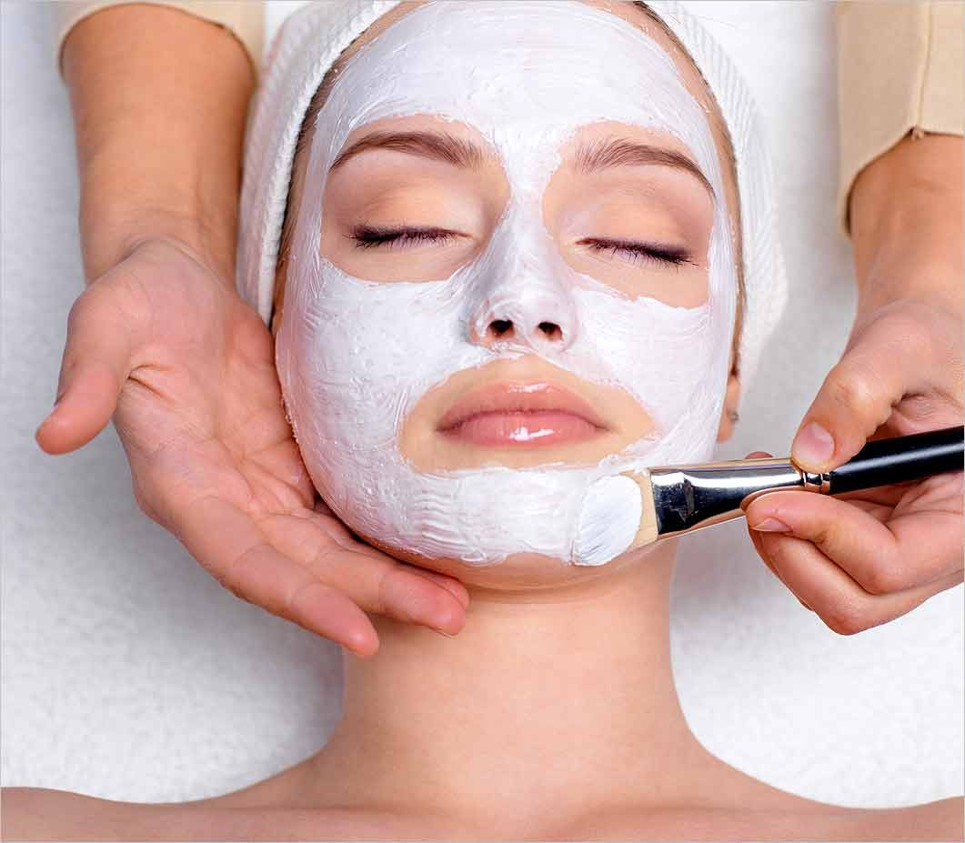

Slide 7
HAIR CUT
1. Plain-Cut ................... 100tk
2. U-Cut ................... 150tk
3. V-cut ................... 150tk
4. Lair-Cut ................... 250tk
5. Step-Cut ................... 180tk
6. Volume-Cut ................... 350tk
7. Bob-Cut ................... 300tk
8. Bench-Cut ................... 120tk
9. Three Step ................... 350tk

Slide 8
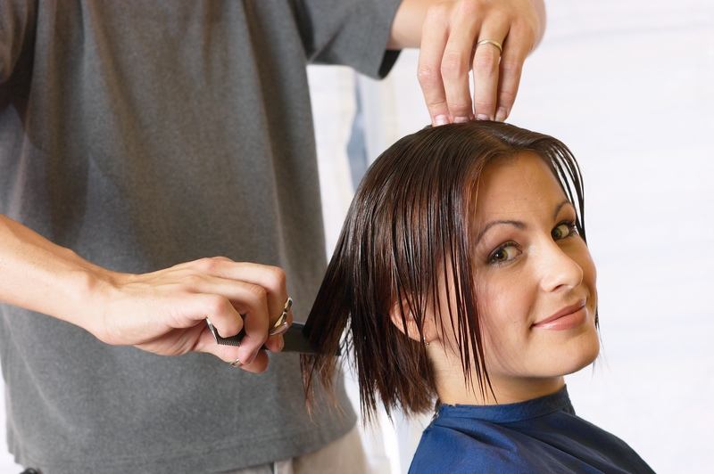
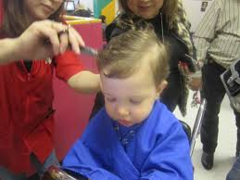

Slide 9
MAKE UP
1.Party make_up ........8000tk..........
2.Normal Make_up ........5000tk..........
3.Bridal Make_up ........15000TK........

Slide 10
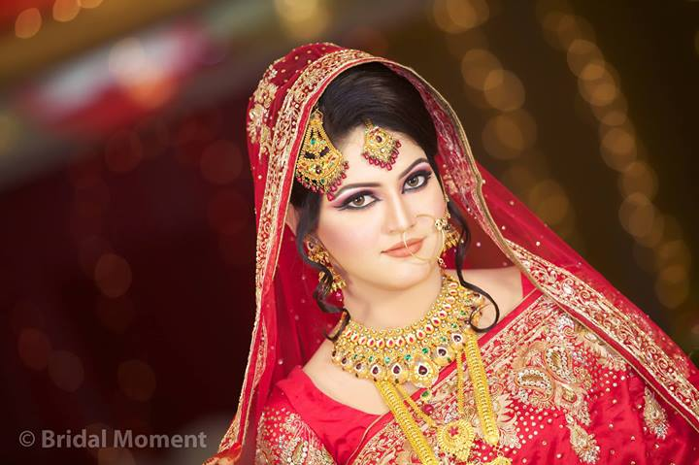
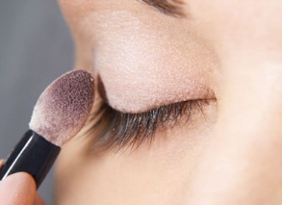
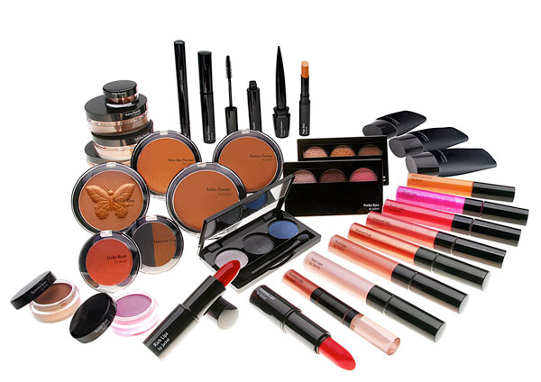

Slide 11
OTHERS
1.Eye-Brow Plug .......... 40tk
2.menicure .......... 200tk
3.pedicure .......... 200tk
4.mehedi .......... 200tk
5.Wearing Sari .......... 200tk

Slide 12
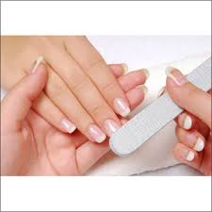
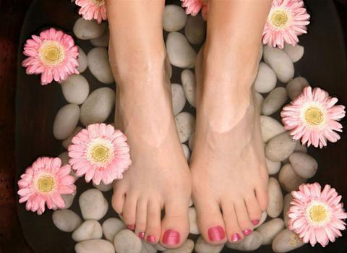
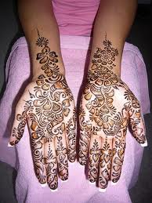
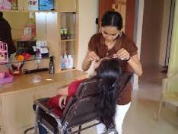

Slide 13
class
class customer
{
void login_menu();
void customer_login();
void customer_register();
void get_input();
void show_room();
void customer_menu_list();
void work();
void customer_main_menu_list();
void search();
};

Slide 14
FUNCTIONS
void login menu()// login part
register part
exit
Void customer login ()//
IN THIS PART CUSTOMERS WILL LOG IN
Void customer_register()
// IN THIS PART CUSTOMERS WILL Register
Void customer_menu_list()//
IN THIS PART IT WILL BE MENTIONED HOW MANY ITEMS ARE OFFERED BY THE PARLOUR AND PRICE OF THE ITEMS.
Void get-input()//
IN THIS PART CUSTOMERS INFORMATION WILL BE ENTERED

Slide 15
cONTINUE
Void show-room()//
IN THIS PART THE ROOM NO WILL BE PRESERVED FOR EACH AND EVERY FUNCTION OF THE PARLOUR.
Void search()
//IN THIS PART IF WE INPUT AN ITEM,IF THAT IS AVAILABLE,THEN IT WILL SHOW…
Void work()
//IN THIS PART IF WE INPUT THE ITEM THAT WE WANT TO DO,IT WILL OUTPUT THE ROOM NO OF THAT PARTICULAR ITEM
Void customer_main_menu_list()// CALL SOME FUNCTION IN CUSTOMER CLASS
};

Slide 16
class
Class authority()
{ void admin_login()
void show_info()
exit
};

Slide 17
functions
void admin login()
//IN THIS PART ADMIN WILL LOGIN..
Void show_info()
//IN THIS PART THE INFORMATION OF THE CUSTOMERS THAT ENTERED WILL BE SHOWN..

Slide 18
class
Class callclass()
{ void call all funtion()
}
FUNCTION::
void call all funtion()
//IN THIS PART CUSTOMER LOGIN FUNCTION AND AUTHORITY LOGIN FUNCTION WILL BE CALLED..

Slide 19
diagram
CLASS CUSTOMER
VOID CUSTOMER LOGIN
VOID CUSTOMER REGISTER
EXIT
VOID GET INPUT()
VOID CUSTOMER MENU LIST()
VOID SHOWROOM()
VOID SEARCH ()
VOID WORK()

Slide 20
CLASS AUTHORITY
VOID ADMIN_LOGIN()
VOID SHOW-INFO()
EXIT

Slide 21
CALL CLASS
VOID LOGIN MENU
VOID ADMIN LOGIN

Slide 22

THANK
YOU
EVERYONE….☺ ☺ ☺

